Slide 2
There are 6 rails: A, B, C, D, E, F
On each rail, there are 2 robots (grey blocks)
Each rail has 16 position: from 0 (the tail of the arrow) to 15 (arrowhead)
The left and the right are indicated by the arrow’s direction.
Rail D
Position 0
Position 15
Position 15
Position 15
Position 15
Rail B
Position 0
Position 0
Rail A
Position 0
Rail F
Position 15
Position 0
Rail E
Position 15
Position 0
Rail C

Slide 3
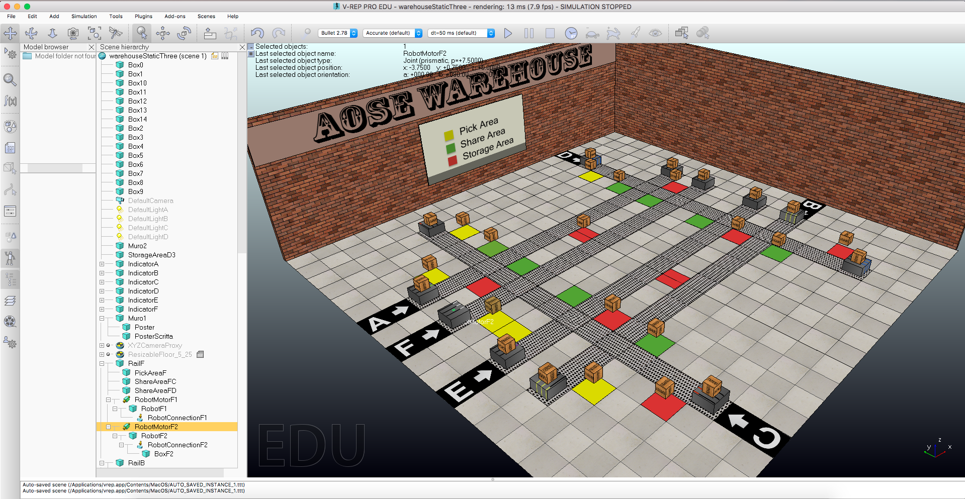
The green areas are the share areas, the yellow ones are the pick areas and the red areas are the storage areas.
The letter indicates the rail. The robots near the letter are in position 0, the others in position 15.

Slide 4
To open the scene:
File -> open scene
Select the warehouseStaticThree.ttt situated in the vrepFiles in the unzipped folder
To run the program use JACK.
After the execution of the program, it will be opened 4 GUI in v-rep as showed in the next slide.
The bigger one is used to move the robot in the environment (moveForeward, moveBackward and stop) and to load unload. It show what the robot data, what it has on his left and right and the other rail crossed.
The smaller one is the timer used to stop, pause and play the program. You can also using the three button in v-rep.
The other ones are used to add/remove boxes from the various areas and to move the robot to a position or test the plan.

Slide 5
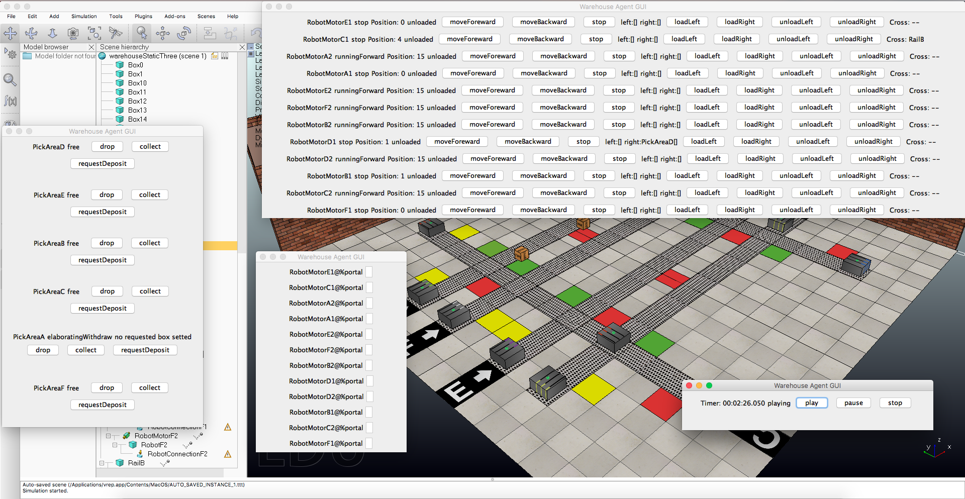
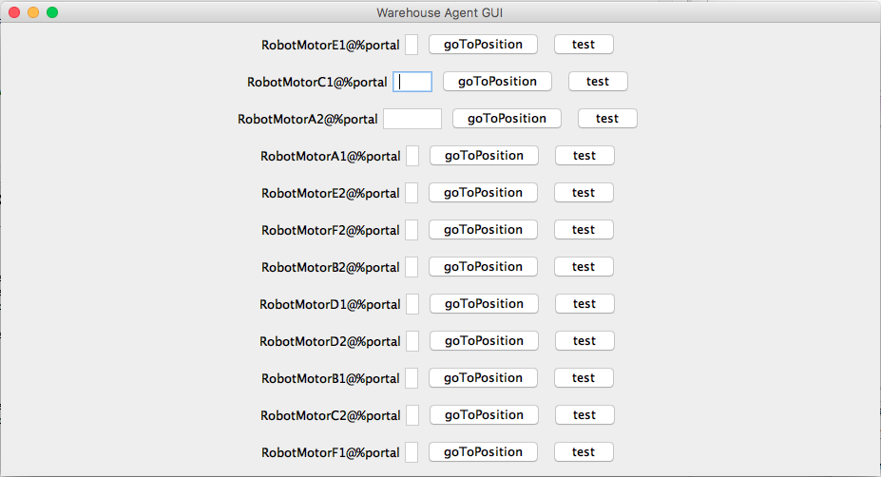
Robot Data
Move the robot
What’s on his left/right
Load/Unload
Other rail crossed
Add or remove boxes
goToPosition/test
Timer

